Slide 1
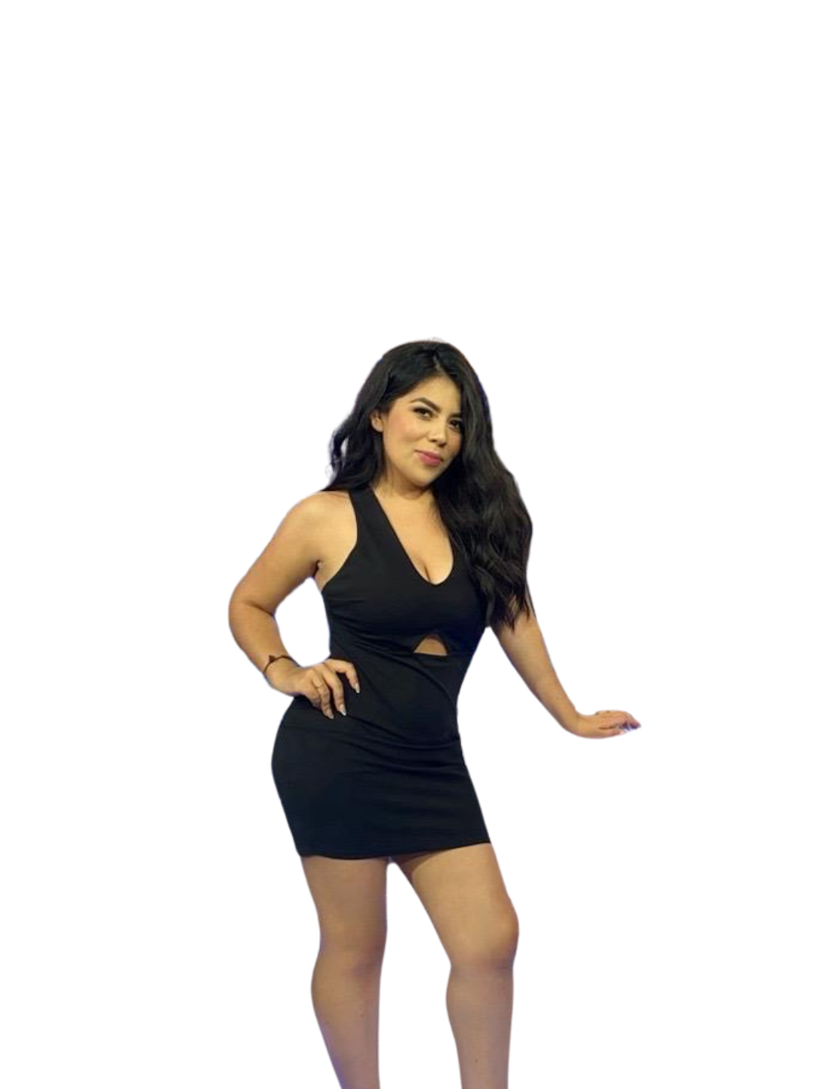



Jennifer Lopez
Que Buena 102.9 M-S 10AM-3PM
Jennifer Lopez was born in Albuquerque, New Mexico and raised in Chihuahua, Chihuahua. She graduated from La Universidad Autonoma de Chihuahua with a masters in science of communication.
She started her career with Mega Radio in Chihuahua with her own morning show that was aired for the past 5 years.
Jennifer really enjoys singing, creating comedy skits, traveling and is family oriented.
This is Jennifers first big move and is thrilled to get started and be a part of the Televisa Univision family.
@

