Slide 1

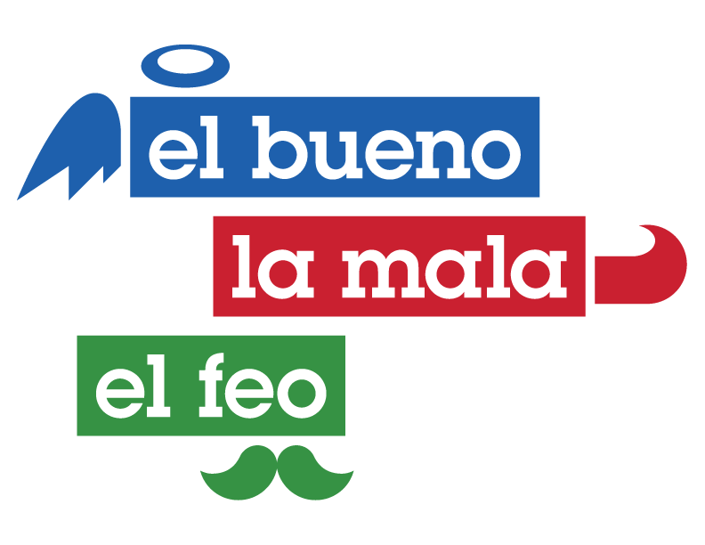
Andrés Maldonado “El Feo”
Andrés, known as the “king" of organic IG reach, shares his ranch life and care for animals with followers, showcasing his mechanical and handyman skills. Beyond social media, he supports animal shelters across cities like Los Angeles, San Diego, Bay Area and Phoenix and champions humane treatment campaigns. His generosity also shines through donations of toys to children in need, inspired by his own childhood challenges. Andrés' actions reflect a deep commitment to both animal welfare and community support, embodying a blend of online influence and real-world impact.
368K+
Followers
271K+
Followers
151K+
Followers

