Slide 1
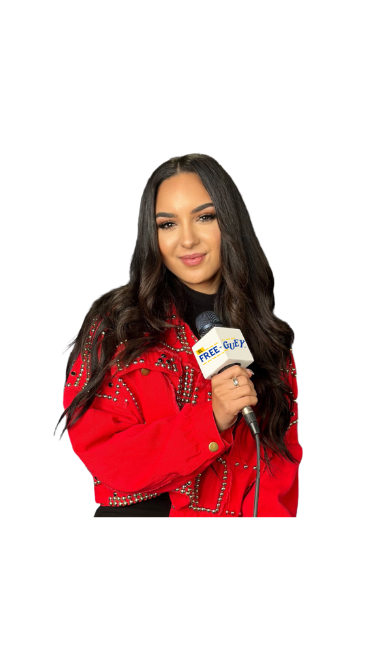

Zayda Cavazos was born and raised in San Diego, CA. She moved to Chicago, IL to pursue a career in radio. Where she got her BA at Columbia College Chicago and gained experience in media production, on-air, music management, journalism, and social media.​
She started her career with Univision in San Diego as the Creative Services Producer. ​
Zayda enjoys traveling, any outdoor activities, watching sports, fashion and hanging out with her family and friends. ​

