Slide 1




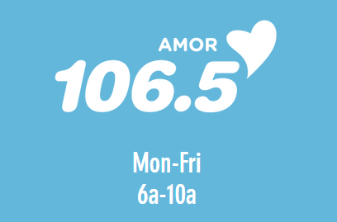

About
Born in Albuquerque, New Mexico, Claudia Talamantez arrived in Austin, TX at a very young age. Since a young age, Claudia has had an obsession with radio. With a radio career spanning more than 18 years, she has worked in a variety of radio formats ranging from Spanish Adult Contemporary, Regional Mexican and Latin Pop Hits.
Claudia has a passion for radio both on air and as a listener. She truly enjoys being behind the microphone and connecting with her audience.
Claudia has been an active supporter of St. Jude Children’s Research Hospital, American Heart Association, SAFE Alliance, Latinitas and numerous fundraising campaigns.
She also enjoys spending quality time with her family, loves working out, DYI house renovation projects, traveling, cooking, reading, attending concerts and music festivals.​

