Slide 1

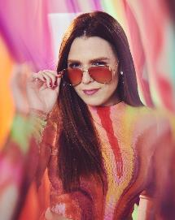


Also known as LA CHAMA, Vicky Van is the youngest Venezuelan radio host in Miami. In the mornings she co-hosts El Flow de Miami, in the evenings she serves as a reporter for Primer Impacto, and at night Vicky lights up MIX 98 with the hottest gossip, local news, and trending topics of the day. She is also a host for Uforia, in charge of artist interviews, concert/event hosting and red carpet coverage in award shows. Her creativity, professionalism and versatility make Vicky a great influencer that can impact any brand. Her light and natural girl-next-door personality makes her relatable to all audiences.
Meet
El Flow
Vicky La Chama
@VICKYLACHAMA

