Slide 1
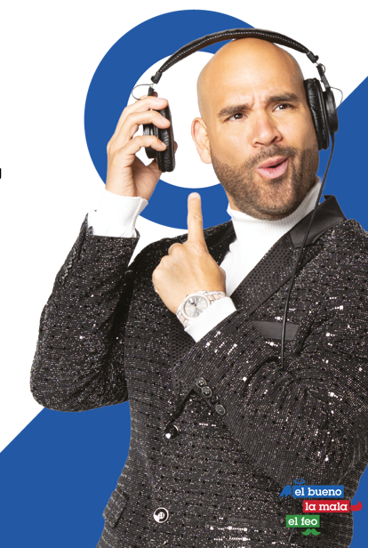
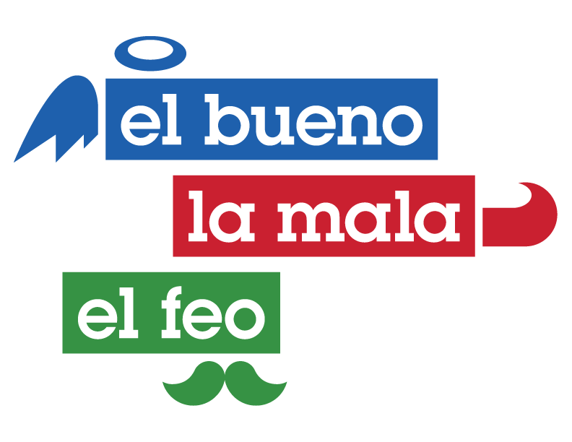
Raúl Molinar “El Bueno”
Raul Molinar, known as "El Pelón," stands as one of the leading Spanish-speaking radio personalities in the United States. With more than two decades of self-taught and instinctive experience in radio, Raul Molinar, also referred to as "El Bueno," effortlessly brings joy and laughter to his audience. He consistently connects with countless listeners, delivering impactful messages of personal growth, motivation, and empowerment. Additionally, Raul Molinar has ventured into the literary world, making his mark as an author with his debut publication, "Rompe Tu Círculo." He is currently working on his second book.
973K+
Followers
454K+
Followers
563K+
Followers

