Slide 1
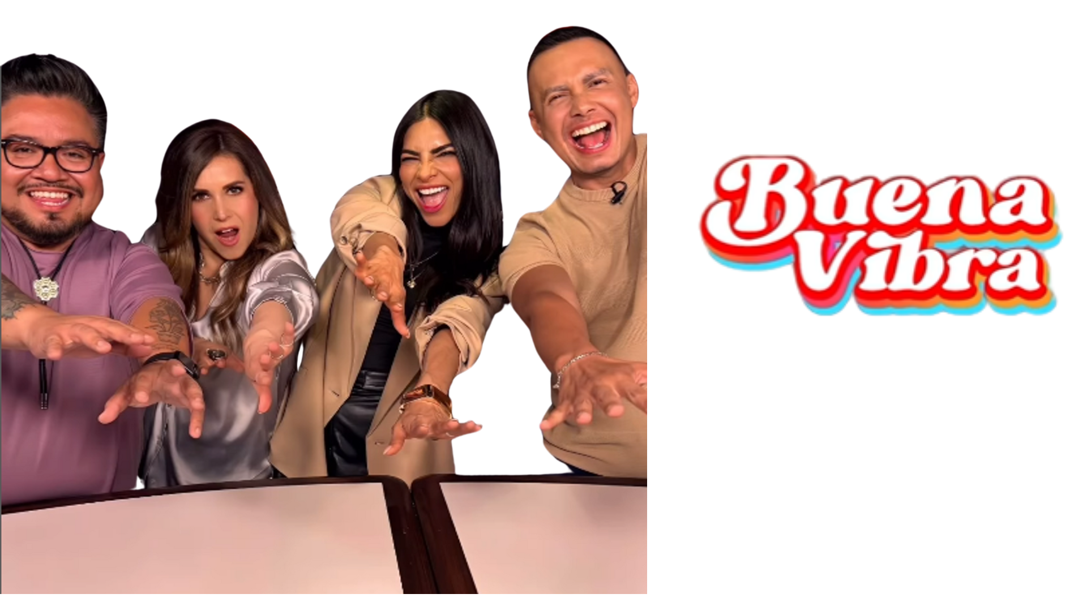


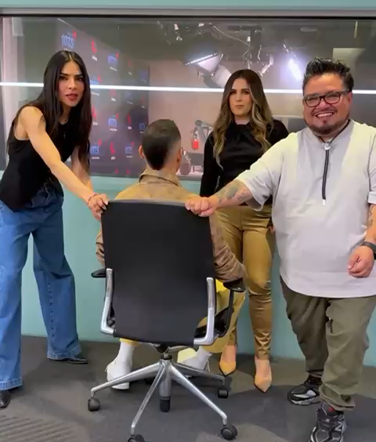

BUENA VIBRA MORNINGS
Now airing weekdays 5–10AM, Buena Vibra brings high-energy music, real talk, and standout personalities to start the day right.
Meet the Team:
Alejandra Espinoza – National TV star bringing charisma and major audience appeal
Luis Sandoval – Beloved from Despierta América, full of heart and humor
Erika Reyna – Trusted radio voice with deep listener connection
Orlando “Panda” – Creative force behind the show’s sharp, fresh tone
@orlandopanda
@luissandovaltv
@erikareyna
@alejandraespinoza
Why Buena Vibra?
Built to connect through music, laughter, and real conversations
Features top talent across TV, digital, and radio
Reaching Latino audiences in 7 major markets
Buena Vibra is where culture, community, and conversation meet.
Hosts: Luis Sandoval, Erika Reyna, Alejandra Espinoza
Producer: Orlando “Panda”
Daypart: Morning Drive 5ap-10a M-F
Target: 18-49 Female lean Male friendly
Tone: Family friendly humor

